Slide 1
MAR 580: Advanced Population Modeling
RTMB
Session I, why (R)TMB?
(Acknowledgements: Mollie Brooks, Kasper Kristensen, Arni Magnusson, Anders Nielsen, André Punt)
Fall 2025

Slide 2
Models in fisheries, fitting to data
Common exercise in fisheries and wildlife science is fitting a model to some data.
These models (and the data they are fit to) can be simple to more complicated.
e.g. regressions, stock-recruitment analysis, population dynamics models, etc.
Optimization tools in statistical software (e.g. lm() , glmer(), or nls() in R) can be used in a lot of instances.
Custom-built objective functions can also be helpful (e.g. using optimize() in R ).
Sometimes these tools can be slow or unstable when our models contain lots of parameters or datasets become large.

Slide 3
What is Template Model Builder?
Put simply, it is an R package to help conduct optimization (parameter estimation) of highly nonlinear models. It includes:
Tools for reading in most interesting data objects (number, vector, matrix, arrays, ...)
Tools for specifying model parameters & constraints (unbounded, bounded, summing to zero, vectors of, ...)
Evaluating the marginal likelihood via Laplace Approximation
Calculation of derivatives of objective function using AD
Helpful functions
Linked workflow with R, allowing for minimization of objective function
Calculations for measures of uncertainty by:
estimating asymptotic variance-covariance matrices,
computing likelihood profiles,

Slide 4

TMB or AD Model Builder?
Many statistical stock assessment software packages in use today are written in ADMB,
e.g. ASAP, Stock Synthesis, CASAL, etc.
This is changing. TMB is (much) faster for random effects models:
e.g. SAM, WHAM,
Workflow similar: write a template file that contains model specification, and how data relate to the model.
Fast because the minimization algorithms use analytical derivatives and a quasi-Newton algorithm.
We need to specify the objective function, but T(AD)MB takes care of the minimization procedure.
No need to supply the derivatives of the function to be minimized with respect to the parameters; these are computed automatically using Reverse Mode Autodifferentiation (the ‘AD’).

Slide 5

What is RTMB?
https://github.com/kaskr/RTMB
RTMB provides R bindings for (a lot of) TMB.
i.e. write R and avoid coding in C++
Other benefits:
Fast to change and re-run models because no compilation is needed.
Debugging can be performed using R debuggers rather than gdb.
Most common TMB features are supported.
Simplified interface can automatically simulate from the model and calculate OSA residuals.

Slide 6
Specifying the Problem – the TMB approach
TMB is an R package. Unlike ADMB, TMB workflow is embedded in R.
TMB programs are written using a template (a file with a .cpp extension).
The .cpp file specifies:
the data (constants) that are part of the function,
the parameters that are to be varied to minimize the function,
variables that depend on the parameters but are not parameters themselves; and
the function to be minimized.
The function itself is minimized from R.

Slide 7
Specifying the Problem – the RTMB approach
RTMB is an R package.
RTMB consists of R code including a function that evaluates the objective function (your model).
RTMB scripts specify:
the data (constants) that are part of the function,
the parameters that are to be varied to minimize the function,
The RTMB model function which includes:
variables that depend on the parameters but are not parameters themselves; and
the objective function (comparison of the model predictions to the data, likelihood).
The function itself is minimized from R.

Slide 8
Work environment – the RTMB approach
R script:
Create list objects for data & model parameters
Write the model function
Build model object (MakeADFun)
Fit model
Analyze results

Slide 9
First example: linear regression

Slide 10
Understanding MakeADFun arguments
func: name of the function
parameters: a list of estimable parameters (including random and fixed effects)
map: provides a way to fix parameters (to not estimate, or make parameters equal)
random: which variables are random effects
control: behaviour of fitting (tolerance, etc.)
We can also specify a data object (list) so that the same model can be fit to different datasets

Slide 11
MakeADFun’s map
Use the map argument to:
Fix parameters at their initial values:
e.g. map = list(b0=factor(NA)) #don’t estimate intercept
Mirror values within a vector
e.g. if you have a vector beta and you want elements 2 & 4 to be the same:
map = list(beta=factor(c(1,2,3,2)))

Slide 12
Reporting
Use REPORT to get results back into R
e.g.
sigma = exp(logSigma);
REPORT(sigma);
Access in R via:
model$report();

Slide 13
Variances for derived quantities
sdreport(model)
- asymptotic variances for parameters
To compute standard errors for derived quantities, define ADREPORT variable:
e.g.
ADREPORT(sigma)
sdreport(model)
summary(sdreport(model))

Slide 14
Programming Style
Comment, comment, comment:
Include comments (indicated by “#”) at the start of the program that states what it does.
Split ideas / blocks of code with blank lines and comments.
Use “inline” comments to refer to equations and meanings of variables.
Indent blocks of code to increase clarity.

Slide 15
Getting Help, and debugging hints
Arrays start at 0 rather than 1, this can confuse R users!
TMB wiki (https://github.com/kaskr/adcomp/wiki)
TMB book (http://kaskr.github.io/adcomp/_book/Introduction.html)
Start simple: develop a routine, test it, develop the next routine, …
Use “std::cout” to output variables to the screen so you can check that the function is being calculated correctly.
Test code by writing out intermediate results (you can then check that values output are correct given the values for the parameters – the first call of the function will involve the parameters being set to their initial values).
Cross compare: Write critical bits of code in EXCEL or R and check you get the correct values.
Never, ever, ever, believe your code is correct: always work on the assumption there is an error somewhere.

Slide 16
Probabilistic syntax
Can use the RTMB ‘tilde operator’ (%~%)
Similar to programming style for JAGS, Stan
May help avoid errors

Slide 17
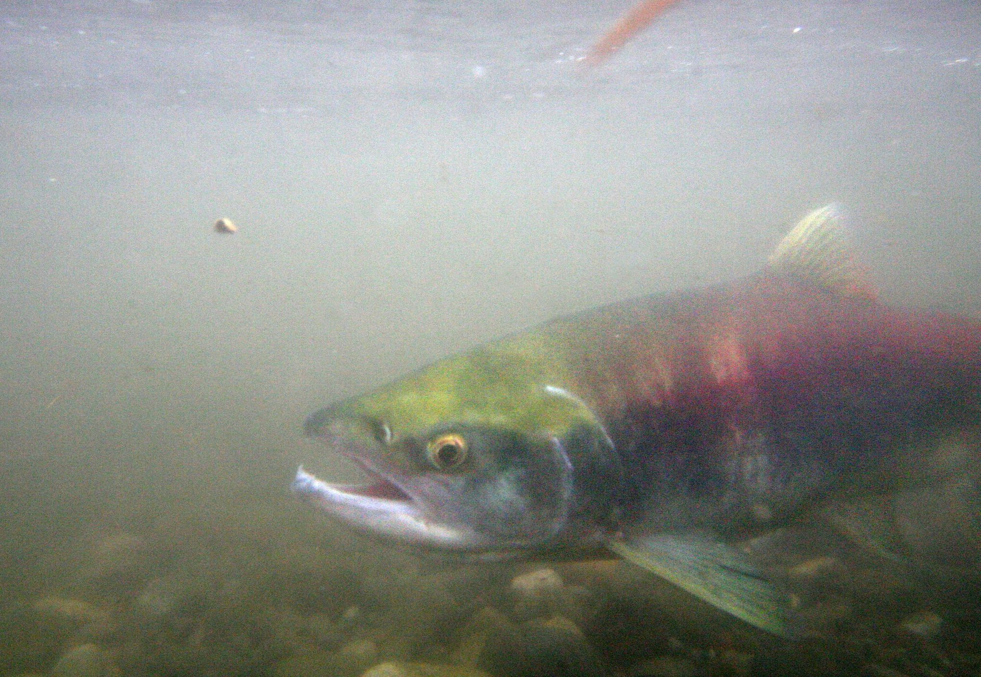



Example: Poisson GLM
Lake Washington sockeye
Salmon counts at the Ballard locks

Slide 18
Exercise: Poisson GLM with covariate
Plot the residuals of the salmon count model with respect to month
Extend the salmon count RTMB model to include a month effect
i.e. Fit the model:
Y(i) ~ Poisson(λ(i))
ln(λ(i)) = β_{month(i)}
Plot the resulting residuals
Compare the model with the month effect to the single-intercept model using AIC.

